Slide 1


DEPARTMENT OF COMPUTER SCIENCE AND ENGINEERING
SmartRide - Vehicle Rental & Booking System
PROJECT STUDENT
K JASHUVA AKHIL, 43612020

Slide 2
AGENDA
Abstract
Existing System
Proposed System
Advantages
Disadvantages
Hardware Requirements
Software Requirements
Modules
Module Description
Sample Output(Screenshot)
Conclusion

Slide 3
Abstract
SmartRide is a smart web-based vehicle rental and management platform designed to make renting vehicles faster, easier, and more reliable. It enables users to browse, compare, and book vehicles online based on their preferences and availability while promoting convenience and transparency by eliminating manual booking and paperwork. The system focuses on sustainability by offering eco-friendly electric vehicles along with traditional options. Users can securely log in, manage bookings, view digital keys, and earn reward points for choosing green rides, while vehicle owners can list their vehicles and earn income through the same platform.
3

Slide 4
Existing System
In the existing system, vehicle rentals are managed manually or through basic, non-interactive websites with limited functionality. Customers often need to call or visit rental offices to check vehicle availability, make reservations, or complete payments, leading to time delays and inconvenience. Record keeping is mostly manual, which increases the chances of errors and data loss. Payment tracking, verification, and refund handling are difficult to manage efficiently. Moreover, the existing systems lack personalized recommendations, a reward mechanism for loyal customers, and advanced features such as real-time vehicle tracking or digital key access. This results in poor user experience, reduced transparency, and limited scalability for both customers and service providers.

Slide 5
Proposed System
SmartRide introduces a smart and efficient web-based platform for modern vehicle rental management. It allows users to easily search, compare, and book vehicles online through a responsive and interactive interface. Vehicle owners can list their cars or bikes, manage bookings, and earn income directly through the platform. The system provides secure user authentication, detailed booking history, and instant digital key generation after booking confirmation for contactless access. It also includes a reward point system to encourage eco-friendly vehicle choices and ensures real-time availability updates for a seamless experience. Overall, SmartRide enhances convenience, transparency, and sustainability in the vehicle rental process.

Slide 6
Advantages
• User-friendly interface
• Instant online booking
• Eco-friendly vehicle options
• Reward points for green rides
• 24/7 accessibility
• Automated booking records

Slide 7
Disadvantages
• Requires stable internet connection
• Limited to registered users
• Security depends on local storage and authentication measures

Slide 8
Hardware Requirements
• Laptop or Desktop PC
• Processor: Intel i3 or higher
• RAM: Minimum 4GB
• Hard Disk: 250GB or more
• Internet Connection

Slide 9
Software Requirements
• Frontend: HTML, CSS, JavaScript
• Backend: LocalStorage (for demo)
• Browser: Chrome / Edge / Firefox
• IDE: VS Code
• Hosting: GitHub Pages or Localhost

Slide 10
Modules
1. User Module
2. Vehicle Module
3. Booking Module
4. Authentication Module
5. Reward Points System
6. Digital Key Access

Slide 11
Module Description
• User Module – Handles registration, login, and logout
• Vehicle Module – Displays available vehicles with details
• Booking Module – Allows users to confirm rentals and calculate cost
• Authentication Module – Protects pages using login validation
• Reward System – Awards eco-points for electric rides
• Digital Key – Generates unique booking key for secure vehicle access

Slide 12
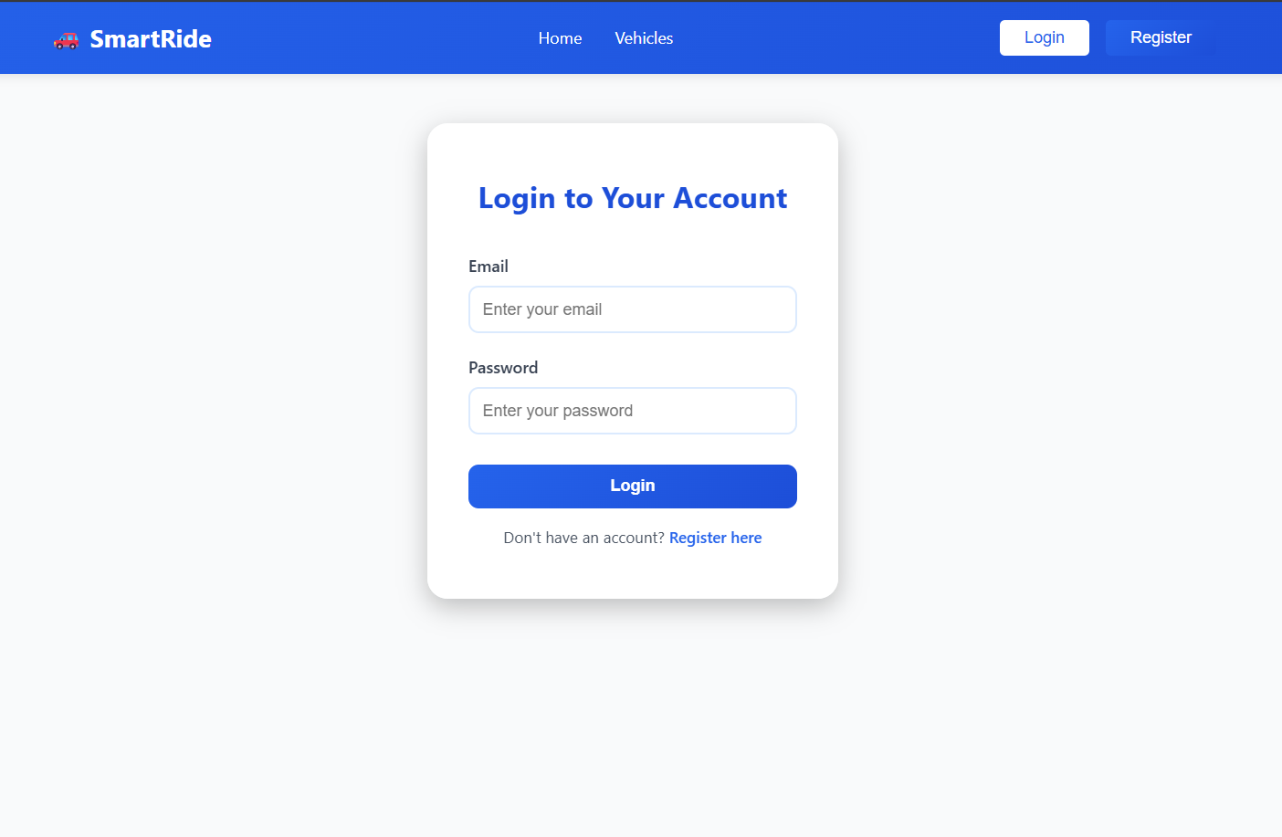
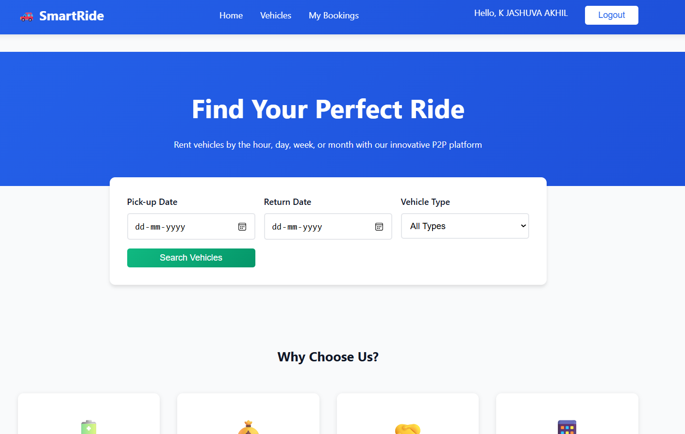
Sample Output(Screenshot)

Slide 13
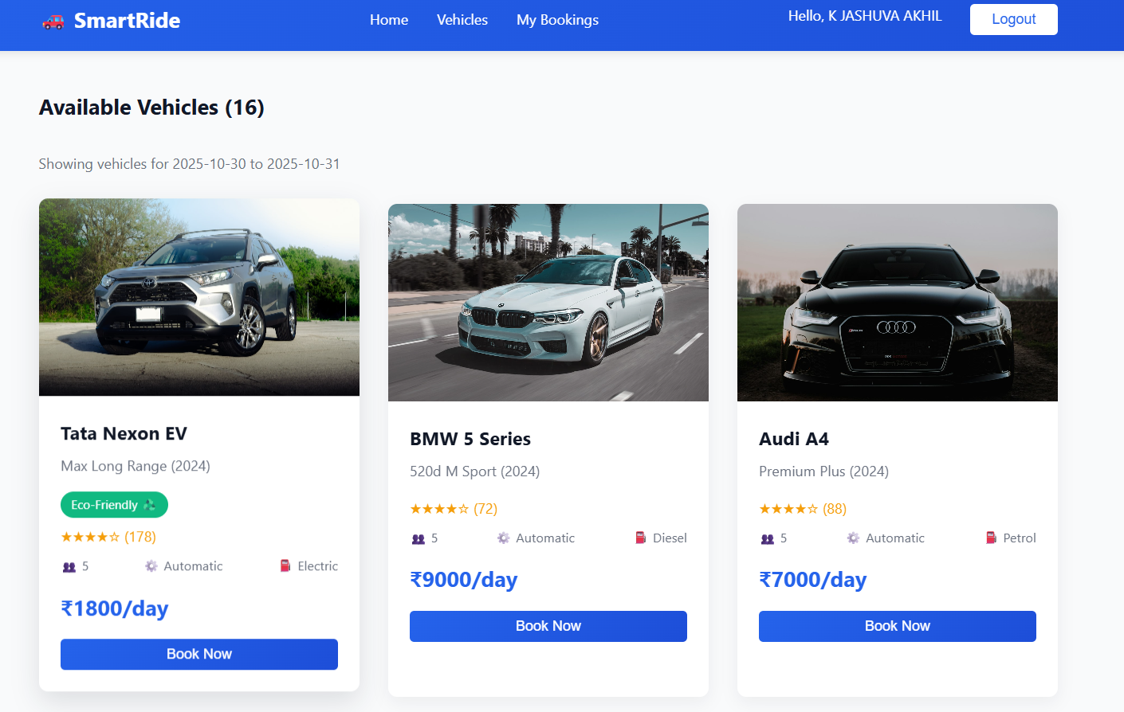
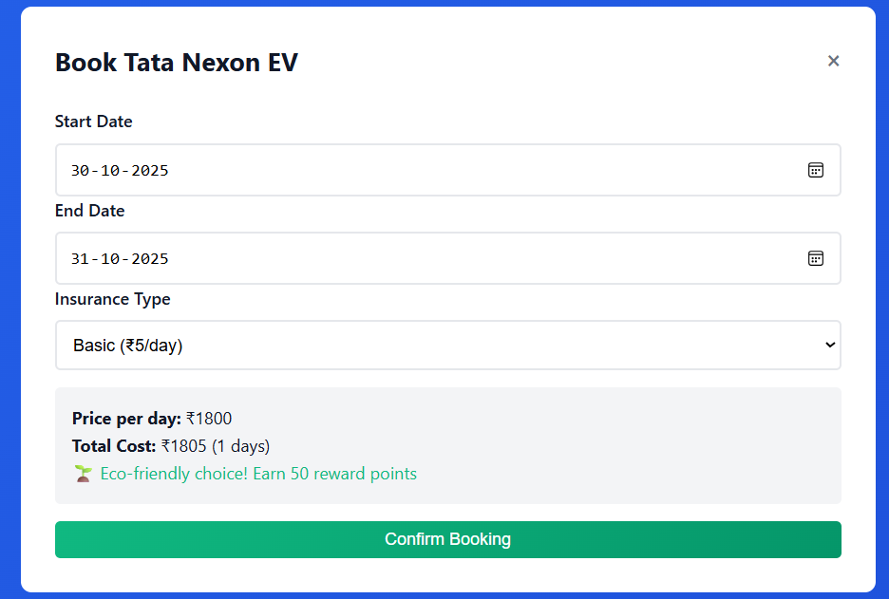
Sample Output(Screenshot)

Slide 14
Conclusion
SmartRide introduces a smart and efficient web-based platform for modern vehicle rental management. It allows users to easily search, compare, and book vehicles online through a responsive and interactive interface. Vehicle owners can list their cars or bikes, manage bookings, and earn income directly through the platform. The system provides secure user authentication, detailed booking history, and instant digital key generation after booking confirmation for contactless access. It also includes a reward point system to encourage eco-friendly vehicle choices and ensures real-time availability updates for a seamless experience. Overall, SmartRide enhances convenience, transparency, and sustainability in the vehicle rental process.

Slide 15
THANK YOU

